Slide 1
Embedded Software: Memory Device Drivers
CSPC61 - Embedded Systems Architectures
Dr. M. Bhuvaneswari
26.03.2022

Slide 2
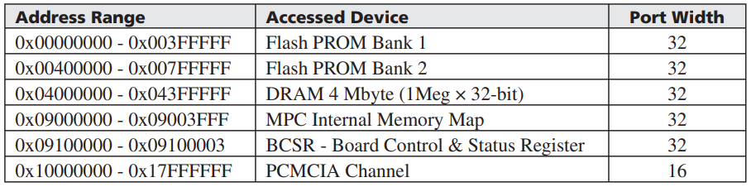
Memory Device Drivers
Physical memory is a two-dimensional arrays (matrices) made up of cells addressed by a unique row and column.
Master processor and programmers - Memory as a large 1D array - Memory Map.
In the memory map, each cell of the array is a row of bytes.
Number of bytes per row depends on the width of the data bus.
It depends on the width of the registers of the master architecture.
Software’s point-of-view - Physical memory - logical memory - Basic unit (byte)
Logical memory is made up of all the physical memory (registers, ROM, and RAM) in the entire embedded system.
Device drivers - Management of the overall memory subsystem.
Manage the memory on the master processor and on the board
Memory management components (memory controller, MMU, registers, cache, ROM, DRAM).
Sample Memory Map

Slide 3
Memory Device Drivers - Functions
All or some combination of six function supported memory access.
Memory Subsystem Startup, initialization of the hardware upon power-on or reset (initialize TLBs for MMU, initialize/configure MMU).
Memory Subsystem Shutdown, configuring hardware into its power-off state.
MPC860 - No necessary shutdown for the memory subsystem.
Memory Subsystem Disable, allowing other software to disable hardware on-the-fly (disabling cache).
Memory Subsystem Enable, allowing other software to enable hardware on-the-fly (enable cache).
Memory Subsystem Write, storing in memory a byte or set of bytes (i.e., in cache, ROM, and main memory).
Memory Subsystem Read, retrieving from memory a “copy” of the data in the form of a byte or set of bytes (i.e., in cache, ROM, and main memory).

Slide 4
Memory Device Drivers - Byte Ordering Scheme
All data within memory is managed as a sequence of bytes.
Memory access is limited to the size of the data bus.
Certain architectures manage access to larger blocks (a contiguous set of bytes) of data – Segment.
More complex address translation scheme Implementation is required.
Logical address: segment number (address of start of segment) and offset (within a segment) → Software → determine the physical address of the memory location.
Byte ordering scheme of an architecture - The order in which bytes are retrieved or stored in memory.
Byte ordering scheme - little endian, big endian
Big endian - the lower byte addresses are used for the more significant bytes (the leftmost bytes) of the word. Bytes are accessed in the order of the highest byte first.
Little endian - the lower byte addresses are used for the least significant bytes (the rightmost bytes) of the word. Bytes are accessed in the order of the lowest byte first.

Slide 5
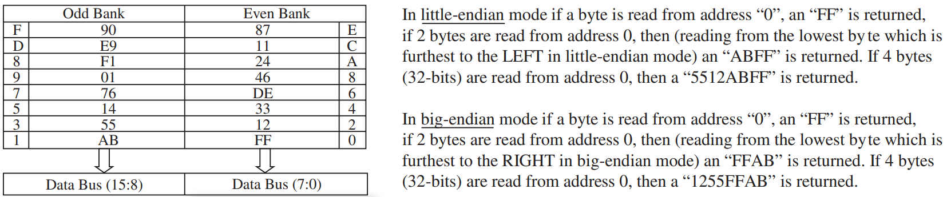
Memory Device Drivers - Byte Ordering Scheme
Memory banks - Memory is plugged into an area on the embedded board.
Configuration and number of banks can vary from platform to platform. Memory addresses are aligned in an odd or even bank format.
Performance can be greatly impacted if data requested isn’t aligned in memory according to the byte ordering scheme defined by the architecture.
If data is aligned in little endian mode, data taken from address “0” in an even bank is “ABFF” - only one memory access is needed.
if data were to be taken from address “1” - the little endian ordering scheme should retrieve “12AB” data - one memory access is needed. - driver code to perform additional work to align them as “12AB”

Slide 6
Memory Management DD - Function Implementation
Implementation of various memory management routines on the MPC860.
Process workflow - startup, disable, enable, and writing/erasing functions.
Memory Subsystem Startup (Initialization) on MPC860
First two banks are 8 MB of Flash memory, DRAM - 4B, 1 MB - Internal memory map and control/status registers and 4 MB of an additional PCMCIA card.
Main memory components (Flash, DRAM) initialized - Initialized via a memory controller, configuring the internal memory map and configuring the MMU.
Initializing the Memory Controller and connected ROM/RAM
MPC860 memory controller - control of up to eight memory banks
Interfacing to SRAM, EPROM, flash EPROM, various DRAM devices, and PCMCIA.
MPC860, on-board memory
is initialized by initializing the
Memory controller.

Slide 7
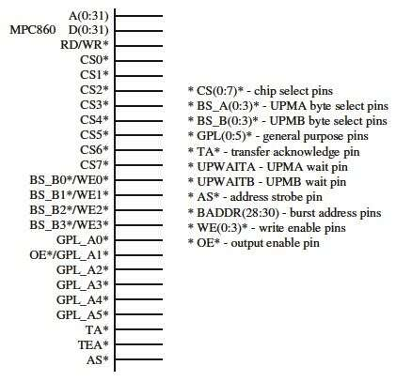
Memory Subsystem Startup
The memory controller of MPC860 has two different types of subunits.
General-purpose chip-select machine (GPCM) - Designed to interface to SRAM, EPROM, Flash EPROM, and other peripherals (such as PCMCIA)
User programmable machines (UPM) - Designed to interface to a wide variety of memory, including DRAMs.
The pinouts of the MPC860’s memory controller connect
these subunits to the various types of memory.
Every chip select (CS) - an associated memory bank.
Every new access request to external memory - memory controller - eight address ranges - 8 base registers (start address of each bank) and option registers (the bank length) pairs.
Memory access is processed - GPCM or UPMs - type of memory located in the memory bank.
MPC860 - Memory controller pins

Slide 8
Memory Subsystem Startup
BR0/OR0 - BR7/OR7: need to be configured in the memory controller initialization drivers.
Base Register (BR) fields – 32 bit length
a 16-bit start address BA (bits 0-16)
AT (bits 17-19) - address type
allows sections of memory space to be limited to only one particular type of data)
a port size (8, 16, 32-bit)
a parity checking bit
a bit to write protect the bank
Allowing for read-only or read/write access to data.
a memory controller machine selection set of bits (for GPCM or one of the UPMs)
a bit indicating if the bank is valid.
The option register (OR) fields
bits of control information for configuring the GPCM and UPMs accessing and
addressing scheme (i.e., burst accesses, masking, multiplexing, etc.).
Type of memory connected to the appropriate CS - to be initialized - registers.

Slide 9
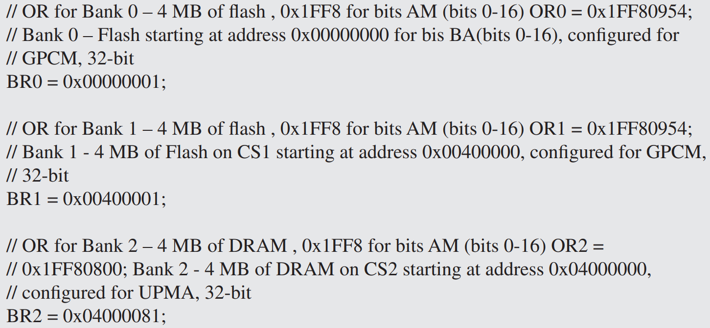
Memory Subsystem Startup
Pseudocode for configuring the first two banks (4 MB of Flash each), and the third bank (4 MB of DRAM)
Memory periodic timer prescaler register (MPTPR) is initialized for the required refresh timeout.
For configuring UPMs - initialization of Mode register (MAMR or MBMR)

Slide 10
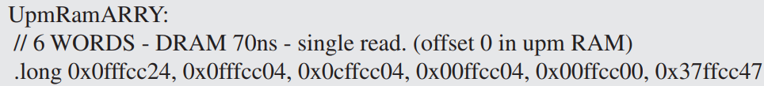
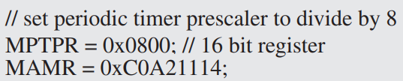
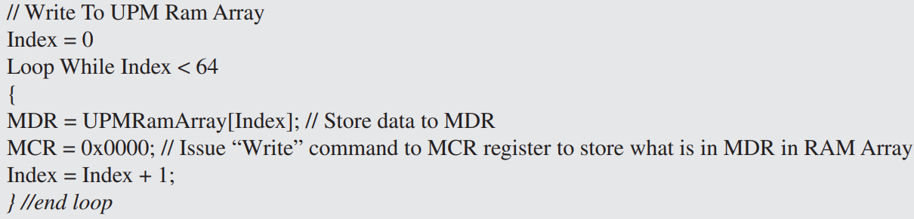
Memory Subsystem Startup
Pseudocode for configuring the first two banks (4 MB of Flash each), and the third bank (4 MB of DRAM)
Memory periodic timer prescaler register (MPTPR) is initialized for the required refresh timeout.
For configuring UPMs - initialization of Mode register (MAMR or MBMR)
The RAM array is initialized via
Memory command register (MCR) - uses to write to or read from the RAM array
Memory data register (MDR), which stores the data the MCR

Slide 11
Memory Subsystem Startup
Initializing the Internal Memory Map on the MPC860
It contains the architecture’s special purpose registers, dual-port RAM (parameter RAM), buffers of the various integrated components (Ethernet or I²C).
Internal Memory Map Register (IMMR)
contains the base address of the internal memory map, and some factory-related information on the specific MPC860 processor.
As per sample memory map, the internal memory map starts at 0x09000000. Hence the IMMR would be set to this value via the “mfspr” or “mtspr” commands.
mtspr 0x090000FF
32 bit address - the top 16 bits are the address, bits 16–23 are the part number // (0x00 in this example), and bits 24–31 is the mask number // (0xFF in this example)
Initializing the MMU on the MPC860
MPC860 uses the MMUs to manage the board’s virtual memory management scheme - providing logical/effective to physical/real address translations, cache control, and memory access protections.
The MMU initialization sequence involves initializing the MMU registers and translation table entries, MMU Instruction Control Register (MI_CTR) and the Data Control Registers (MD_CTR)

Slide 12
Memory Subsystem - Enable and Disable
Memory Subsystem Disable on MPC860
Disable MMU
Disable translation, IR and DR bits need to be cleared
Disable Caches
Memory Subsystem Enable on MPC860
Enable MMU via setting IR and DR bits
Set the IR and DR bits
Enable translation
Enable caches
unlock all in both caches
invalidate all in both caches

Slide 13
Memory Subsystem
Memory Subsystem Writing/Erasing Flash
Reading from Flash is the same as reading from RAM.
Accessing Flash for writing or erasing - more complicated.
Flash memory is divided into blocks - Sectors.
Each sector is the smallest unit that can be erased.
Flash erase function notifies the flash chip of the impending operation, sends the command to erase the sector and then loops, polling the flash chip to determine when it completes.
At the end of the erase function, the Flash is then set to standard read mode.

Slide 14
Topics Covered
Introduction to memory device drivers
Memory Device Driver Functions
Byte Ordering Scheme
Function Implementation
Memory Subsystem Startup
Initializing the Memory Controller and connected ROM/RAM

